Slide 1



STEGANOGRAPHY
-The art of secret writing
PRESENTATION BY
Dhruvin Padsala 12002080601026
Darsh Godhani 12002080601016
Meet Avaiya 12002080601061

Slide 2
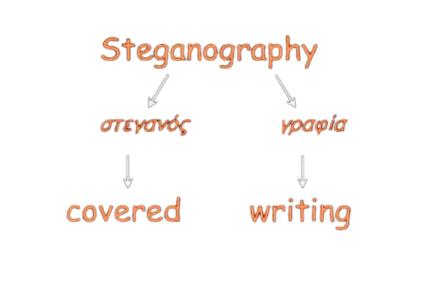
Steganography
Steganography is art of hiding the message.
Signal or message imposed on content.
Steganography is a method of hiding secret data, by embedding it into an audio, video, image, or text file.
It is one of the methods employed to protect secret or sensitive data from malicious attacks.

Slide 3
Classic techniques
1
2
3
Invisible Ink
(1st century AD - WW II)
Tatoo message
Overwrite select characters in printed using pencil
4
5
6
Microdots (WW II)
Newspaper clippings
XOXO signature

Slide 4
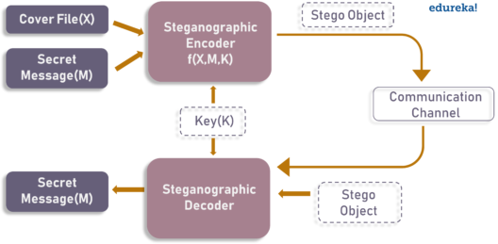
Image Steganography
As the name suggests, Image Steganography refers to the process of hiding data within an image file.
The image selected for this purpose is called the cover image and the image obtained after steganography is called the stego image.
Purpose of this technique is hiding the data within the image in such a way that prevents the unintended user from the detection of the hidden message or data.

Slide 5
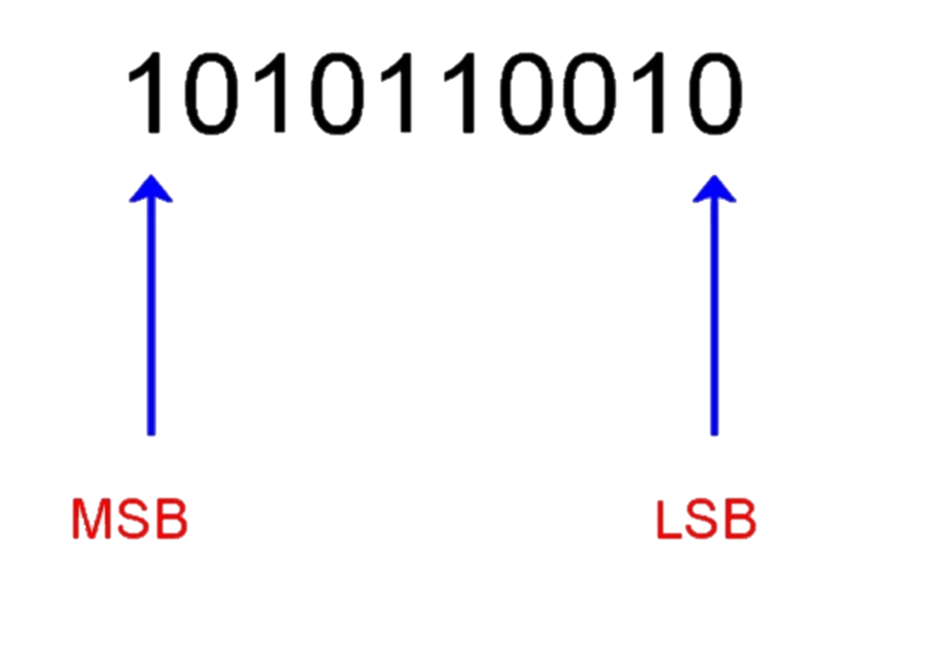
Technique for image Steganography
Least Significant Bit (LSB)
Most Significant Bit (MSB)
We can describe a digital image as a finite set of digital values, known as Pixels. Pixels are the smallest individual element of an image.
LSB (or Least Significant Bit) is a method where we can modify the last bit of every pixel, replacing them with the data bit of the secret message.
MSB (or Most Significant Bit) is a method where we can modify the first bit of every pixel, replacing them with the data bit of the secret message.

Slide 6

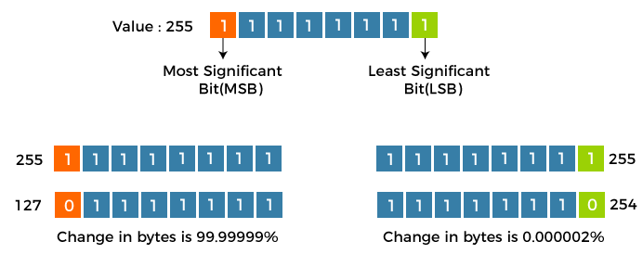


From the above image, we can observe that if we alter the Most Significant Bit (or MSB), it will have a larger impact on the final values;
However, if we alter the Least Significant Bit (or LSB), the impact on the final value is minimal. Hence, we use Least Significant Bit (LSB) Steganography.

Slide 7
Understanding the working of the Least Significant Bit technique
Each pixel consists of three values - Red, Green, Blue.
These values range from 0 to 255, which means that they are 8-bit values. Suppose that we want to hide the message "hi" into an image of size 4x4.
Binary value of the “HI” is: 0110100 0110101.
Now, we can iterate through the pixel values one after one. Once we convert them into binary,
we can replace each least significant bit with that message bits in a sequential manner (the binary of 225
is 11100001, we can then replace the last bit, the bit in the right (1), with the initial data bit (0) and so on).
The output values of the pixels after performing LSBS is as follows:
[(225, 12, 99), (155, 2, 50), (99, 51, 15), (15, 55, 22), (155, 61, 87), (63, 30, 17), (1, 55, 19), (99, 81, 66), (219, 77, 91), (69, 39, 50), (18, 200, 33), (25, 54, 190)]
[(224, 13, 99), (154, 3, 50), (98, 50, 15), (15, 54, 23), (154, 61, 87), (63, 30, 17), (1, 55, 19), (99, 81, 66), (219, 77, 91), (68, 40, 51), (18, 199, 33), (26, 54, 191)]

Slide 8
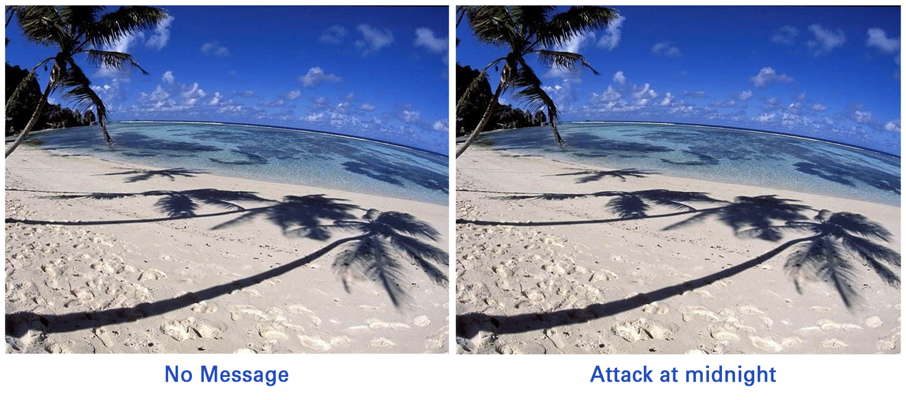
Example

Slide 9
Audio
Steganography
Embedding secret messages into digital sound is known as Audio Steganography.
Audio Steganography methods can embed messages in WAV, AU, and even MP3 sound files.
The properties of the human auditory system (HAS) are exploited in the process of audio Steganography

Slide 10
Technique for audio Steganography
Least Significant Bit (LSB)
We can describe a digital Audio as a finite set of digital values, known as Bits. Bits carries the data of the audio.
LSB (or Least Significant Bit) is a method where we can modify the last bit of every group of 16th or 8th bit , replacing them with the data bit of the secret message.

Slide 11
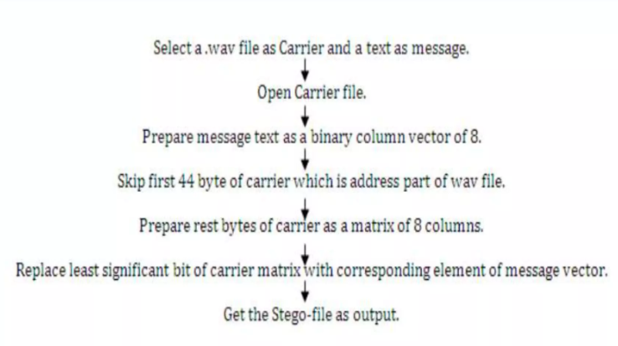
Flow Chart

Slide 12
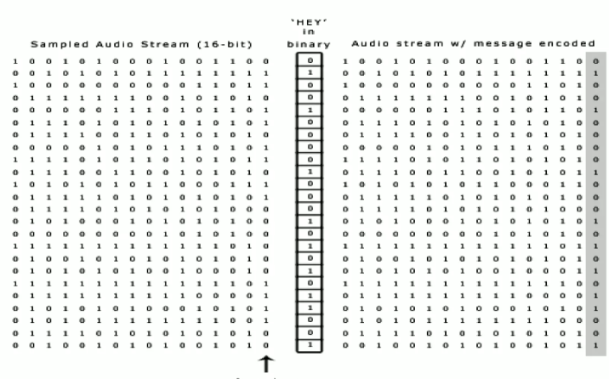
Example

Slide 13
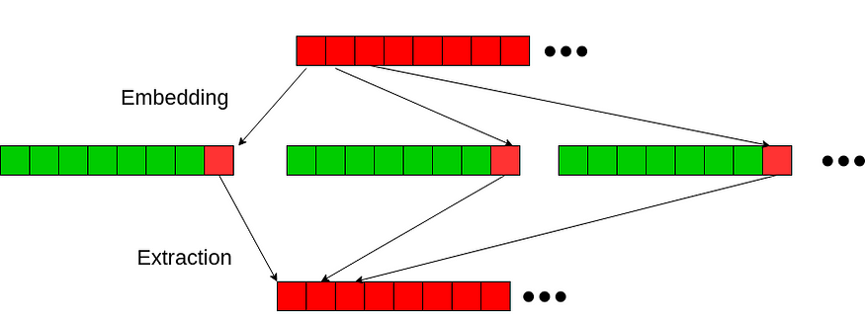
LSB (Least Significant Bit) Algorithm

Slide 14
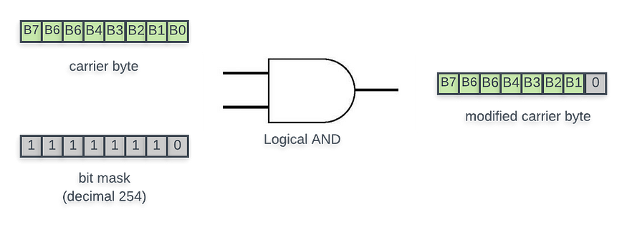
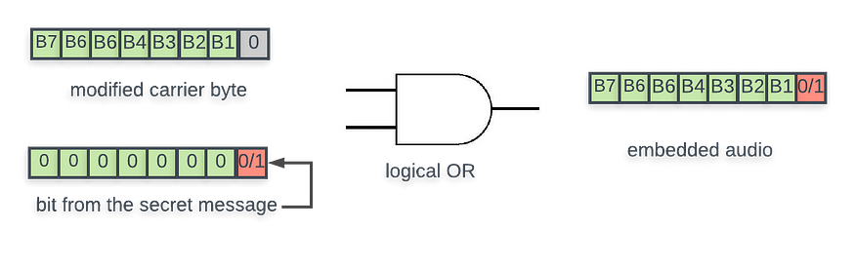
The underlying bit manipulation in LSB is pretty straightforward. We will perform logical AND operation between each byte of carrier audio (the “song”) and a bit mask that resets the LSB of carrier byte.
Then we will perform a simple logical OR operation between the modified carrier byte and the next bit (0 or 1) from the secret message.
We will use .wav audio file format for our carrier song. Wave is one of the most popular lossless compression format. Python has a native library called “wave” that provides us basic tools to manipulate audio data.

Slide 15


Application
Confidential communication and secret data storing.
Protection of data alteration.
Access control system for digital content distribution.
Media database system.
Transport Highly private document between international government.
Transmit message/data without revealing the existence of available message.

Slide 16
Thank You

